Slide 1
Using the EPOSTL in EFL Teacher Education
A tool for language teacher education
IUFE Holli Schauber ETAI 2016

Slide 2
Agenda
EPOSTL in a Nutshell
EPOSTL Descriptors
Use in EFL Teacher Preparation
EPOSTL Footprints
IUFE Schauber ETAI 2016

Slide 3
EPOSTL in a Nutshell European Portfolio for Student Teachers of Language (2007)
Pan-European initiative of ECML to support innovative practices in FL teacher preparation
195 descriptors of core competences in light of prevailing theories
Teacher learning tool that emphasizes:
reflection
learner autonomy
IUFE Schauber ETAI 2016

Slide 4
EPOSTL in a Nutshell
Motivation to use EPOSTL…
1) Delivery system:
-essential FL teaching skills and knowledge
-reinforces the rationales and approaches to FL teaching and learning,
-anchored to core components of our program.
2) Conversations it nurtures:
-explicit and contextually driven knowledge which we associate with significant teacher learning.
IUFE Schauber ETAI 2016

Slide 5
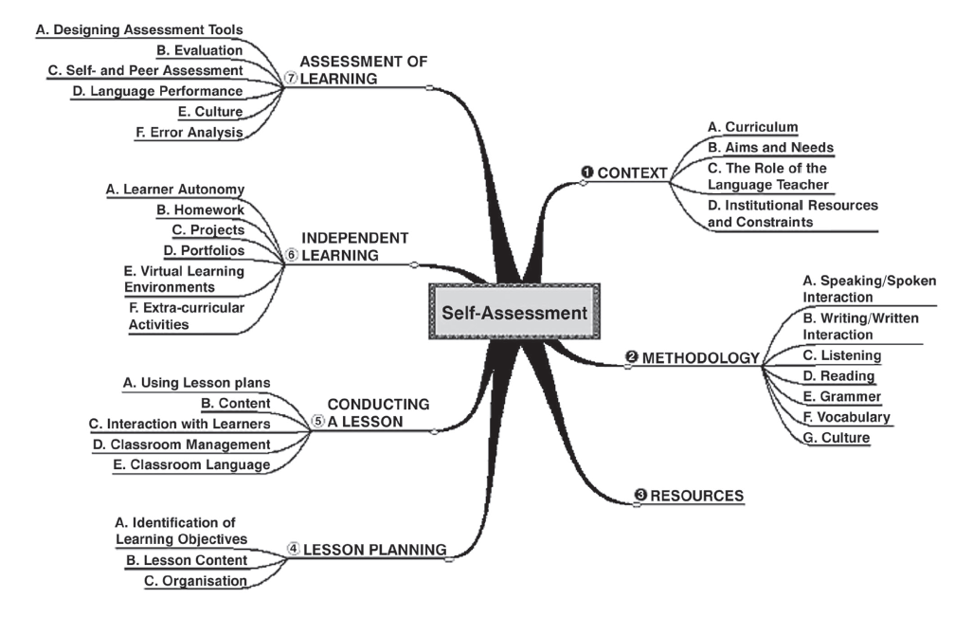
7 EPOSTL Sections = 195 descriptors
IUFE Schauber ETAI 2016

Slide 6
Descriptors- Core Competences
Speaking and Spoken Interaction
1. I can create a supportive atmosphere that invites learners to take part in speaking activities. 06.03.15 24.02.16 18.04.16
Vocabulary
2. I can evaluate and select tasks which help learners to use new vocabulary in oral and written contexts. 09.12.15 02.03.16 18.05.16
The role of the language teacher
3. I can take into account the knowledge of other languages learners may already possess and help them to build on this knowledge when learning additional languages. 11.12.15 12.04.16 21.06.16
IUFE Schauber ETAI 2016
Notes:
Unfortunately vocabulary only has 3 descriptors which we have always found

Slide 7
EMPSBL
EPOSTL
IUFE Schauber ETAI 2016
Notes:
When we first began using the EPOSTL in 2008 I gave it the nickname EMPOSBL because we weren’t quite sure how we were going to manage the vast amount of information it contains nor how we were going to introduce or use the EPOSTL so that it would be coherent across the different elements of our program

Slide 8
Teacher Learning Opportunities with the EPOSTL
Methods classes
Lesson planning
Observations, debriefing and reports
Reflection (individual and dialogic)
Self-assessment
Objective setting
Certification criteria
IUFE Schauber ETAI 2016
Notes:
Methods classes we refer to the descriptors suggested by the theme of the class and we ask students to analyze teaching videos and apply the relevant descriptors and then justify their choices of descriptors student teachers use the EPOSTL descriptors to support their lesson planning objectives we use the descriptors to describe our observations and as part of debriefing and observation reports the debriefing typically morphos into an opportunity for reflection that is independent or dialogic and the teachers are encocuraged to self assess and set objectives for following lessons finally we use two separate sets of descriptors for certification

Slide 9
EPOSTL FOOTPRINTS
Teacher autonomy
Theory practice bridge (teacher buy-in)
Reflective practice
IUFE Schauber ETAI 2016
Notes:
Teacher autonomy-make informed decisions and selections regarding relevant descriptors reduces the gap between theory and practice because the descriptors deliver information that is theory driven and how to at the same time and FINALLY it instills the importance of reflection in teacher learning and beyond and provides learners with an anchor for being a reflective practitioner

Slide 10
References
Burkert, A. &. Schwienhorst, K., (2008). Focus on the student teacher: The European portfolio for student teachers of languages as a tool to develop teacher autonomy. Innovation in Language Learning and Teaching, pp. 2(3), 238-252.
Grenfell M (2012) The EPOSTL and the European Profile for Language Teacher Education. In: Newby D (ed.). Insights into the European Portfolio for Student Teachers of Languages (EPOSTL), Newcastle upon Tyne: Cambridge Scholars Publishing, pp. 155-174.
Newby, D., Allan, R., Fenner, A. B., Jones, B., Komorowska, H., & Soghikyan, K., (2007). European Portfolio for Student Teachers of Languages: A reflection tool for language (EPOSTL). European Council on Modern Languages. Graz, Austria: Council of Europe.
Newby, D. (2012). Supporting good practice in teacher education through the European Portfolio for Student Teachers of Languages. Innovation in Language Learning and Teaching, 6(3), 207-218.
Schauber, H. (2015) Using the EPOSTL for Dialogic Reflection in EFL Teacher Education.
GIST Education and Learning Research Journal. #11 July/December.
IUFE Schauber ETAI 2016

Slide 11
IUFE Schauber ETAI 2016

